Slide 1
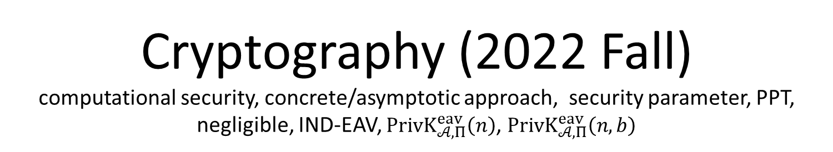
Cryptography (2022 Fall) computational security, concrete/asymptotic approach, security parameter, PPT, negligible, IND-EAV, $PrivK_{𝒜, Π}^{eav}\left(n\right)$, $PrivK_{𝒜, Π}^{eav}\left(n,b\right)$
LiangFeng Zhang
zhanglf@shanghaitech.edu.cn
SIST, ShanghaiTech

Slide 2
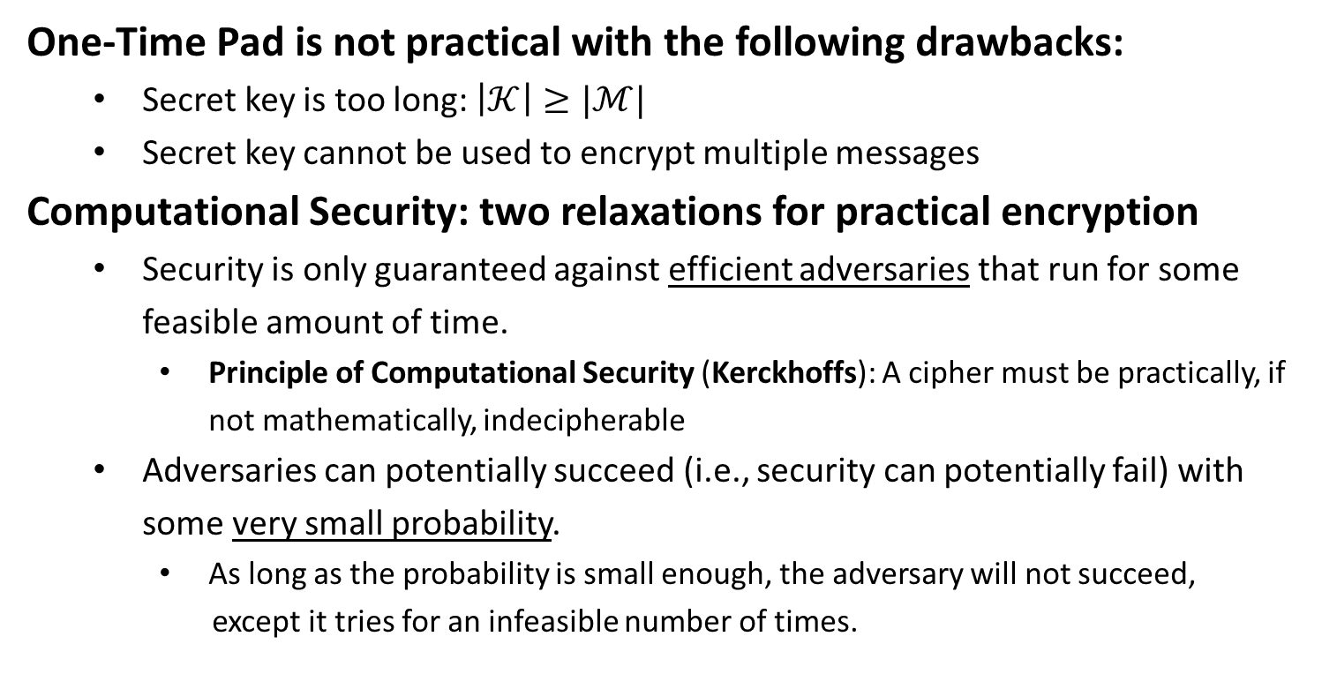
Computational Security
One-Time Pad is not practical with the following drawbacks:
Secret key is too long: $\left|𝒦\right|≥|ℳ|$
Secret key cannot be used to encrypt multiple messages
Computational Security: two relaxations for practical encryption
Security is only guaranteed against efficient adversaries that run for some feasible amount of time.
Principle of Computational Security (Kerckhoffs): A cipher must be practically, if not mathematically, indecipherable
Adversaries can potentially succeed (i.e., security can potentially fail) with some very small probability.
As long as the probability is small enough, the adversary will not succeed,
except it tries for an infeasible number of times.

Slide 3
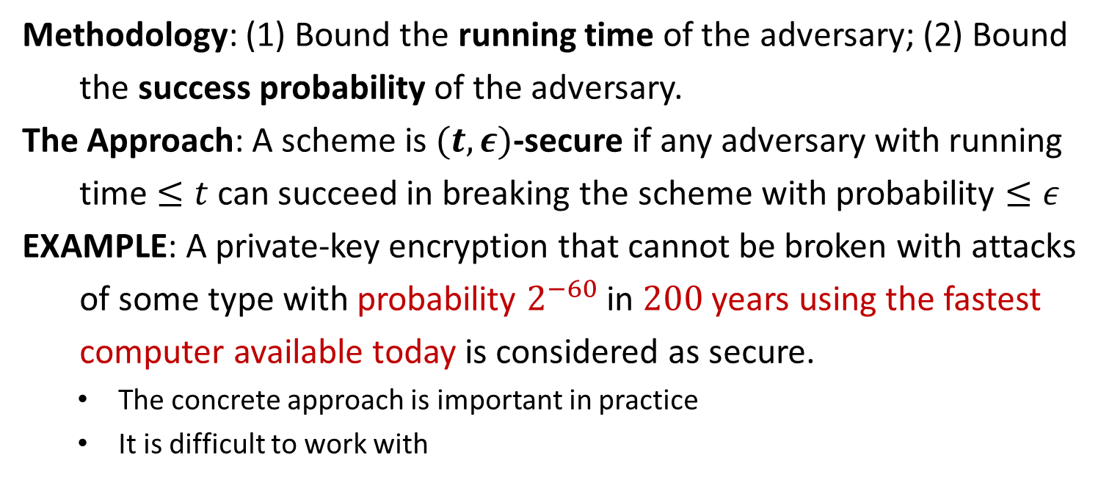
Concrete Approach
Methodology: (1) Bound the running time of the adversary; (2) Bound
the success probability of the adversary.
The Approach: A scheme is $(t,ε)$-secure if any adversary with running
time $≤t$ can succeed in breaking the scheme with probability $≤ε$
EXAMPLE: A private-key encryption that cannot be broken with attacks
of some type with probability $2^{−60}$ in $200$ years using the fastest
computer available today is considered as secure.
The concrete approach is important in practice
It is difficult to work with

Slide 4
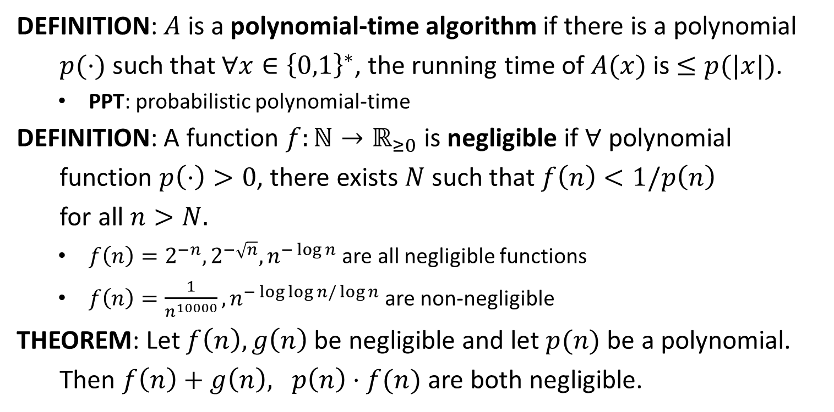
PPT and Negligible
DEFINITION: $A$ is a polynomial-time algorithm if there is a polynomial
$p(⋅)$ such that $∀x∈{\left\{0,1\right\}}^{∗}$, the running time of $A(x)$ is $≤p(|x|)$.
PPT: probabilistic polynomial-time
DEFINITION: A function $f:ℕ→ℝ_{≥0}$ is negligible if $∀$ polynomial
function $p\left(⋅\right)>0$, there exists $N$ such that $f\left(n\right)<1/p\left(n\right)$
for all $n>N.$
$f\left(n\right)=2^{−n}, 2^{−\sqrt{n}}, n^{−\log{n}}$ are all negligible functions
$f\left(n\right)=\frac{1}{n^{10000}}, n^{−\log{\log{n}/\log{n}}}$are non-negligible
THEOREM: Let $f\left(n\right), g\left(n\right)$ be negligible and let $p(n)$ be a polynomial.
Then $f\left(n\right)+g\left(n\right), p\left(n\right)⋅f(n)$ are both negligible.

Slide 5
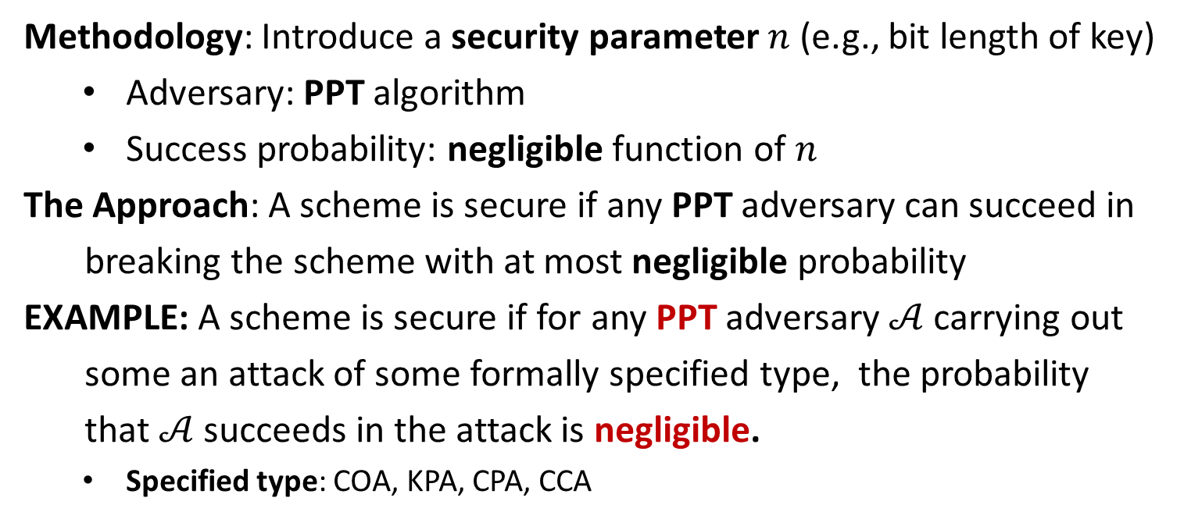
Asymptotic Approach
Methodology: Introduce a security parameter $n$ (e.g., bit length of key)
Adversary: PPT algorithm
Success probability: negligible function of $n$
The Approach: A scheme is secure if any PPT adversary can succeed in
breaking the scheme with at most negligible probability
EXAMPLE: A scheme is secure if for any PPT adversary $𝒜$ carrying out
some an attack of some formally specified type, the probability
that $𝒜$ succeeds in the attack is negligible.
Specified type: COA, KPA, CPA, CCA

Slide 7







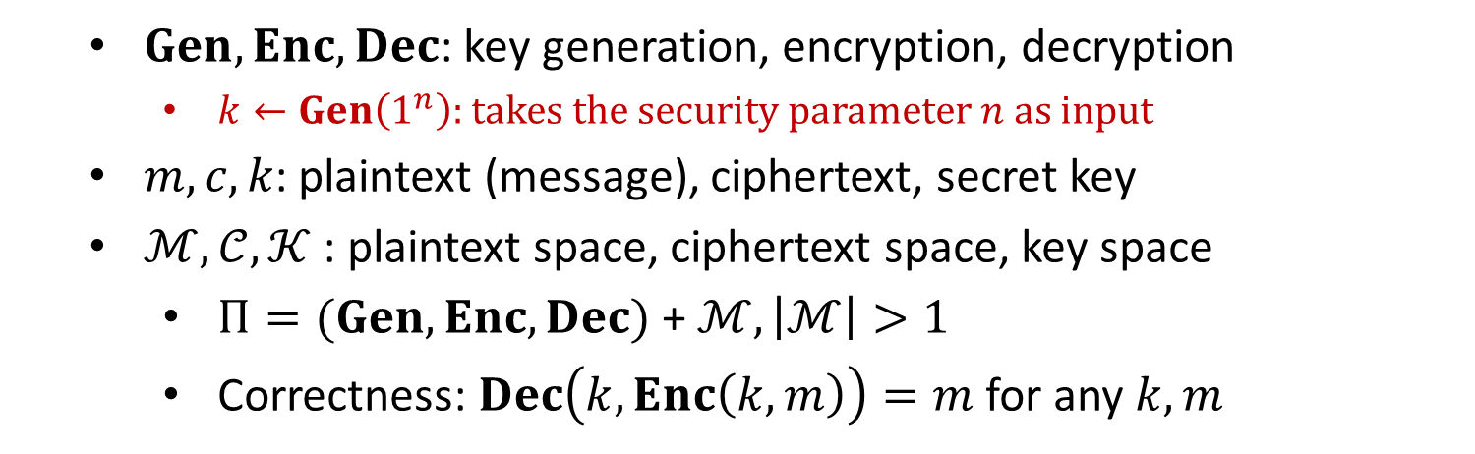



Private-Key Encryption
$$m$$
$$Enc$$
$$c←Enc(k, m)$$
$$Dec$$
Alice
Bob
$$k$$
$$k$$
$$Dec(k, c)=m$$
$$Gen$$
$Gen, Enc, Dec$: key generation, encryption, decryption
$k←Gen\left(1^{n}\right):$ takes the security parameter $n$ as input
$m, c, k$: plaintext (message), ciphertext, secret key
$ℳ,𝒞, 𝒦$ : plaintext space, ciphertext space, key space
$Π=(Gen, Enc, Dec)$ + $ℳ, \left|ℳ\right|>1$
Correctness: $Dec\left(k,Enc\left(k,m\right)\right)=m$ for any $k,m$

Slide 8




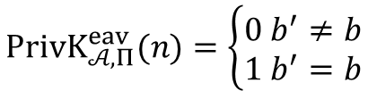


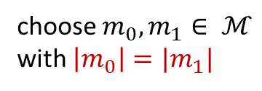

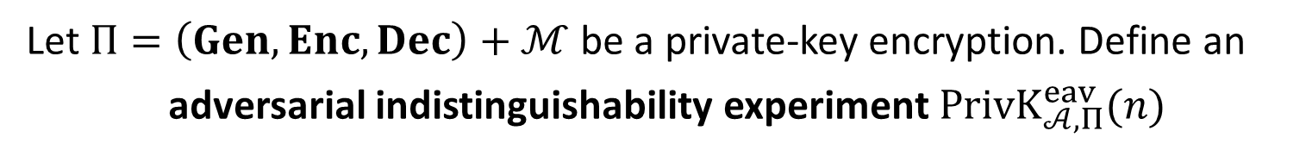


$$PrivK_{𝒜, Π}^{eav}(n)$$
Let $Π=\left(Gen, Enc, Dec\right)+ℳ$ be a private-key encryption. Define an
adversarial indistinguishability experiment $PrivK_{𝒜, Π}^{eav}(n)$
choose $m_{0}, m_{1}∈ ℳ$
with $\left|m_{0}\right|=|m_{1}|$
$$m_{0},m_{1}$$
$$k←Gen\left(1^{n}\right)$$
$$b←\{0,1\}$$
$$Challenger$$
$$c←Enc(k,m_{b})$$
$$Adversary 𝒜$$
$$c$$
$$b′$$
$$PrivK_{𝒜, Π}^{eav}(n)=\left\{\begin{aligned}0 b^{′}≠b \\ 1 b^{′}=b\end{aligned}\right.$$

Slide 9
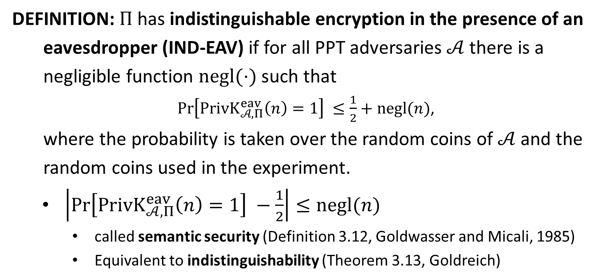
IND-EAV
DEFINITION: $Π$has indistinguishable encryption in the presence of an
eavesdropper (IND-EAV) if for all PPT adversaries $𝒜$ there is a
negligible function $negl(⋅)$ such that
$\operatorname{Pr}\left[PrivK_{𝒜, Π}^{eav}\left(n\right)=1\right] ≤\frac{1}{2}+negl(n)$,
where the probability is taken over the random coins of $𝒜$ and the
random coins used in the experiment.
$\left|\operatorname{Pr}\left[PrivK_{𝒜, Π}^{eav}\left(n\right)=1\right] −\frac{1}{2}\right|≤negl(n)$
called semantic security (Definition 3.12, Goldwasser and Micali, 1985)
Equivalent to indistinguishability (Theorem 3.13, Goldreich)

Slide 10

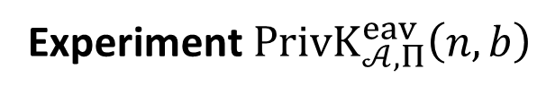





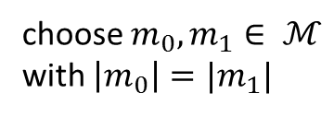



$$PrivK_{𝒜, Π}^{eav}\left(n,b\right)$$
Let $Π=\left(Gen, Enc, Dec\right)+ℳ$ be a private-key encryption.
Experiment $PrivK_{𝒜, Π}^{eav}\left(n,b\right)$
choose $m_{0}, m_{1}∈ ℳ$
with $\left|m_{0}\right|=|m_{1}|$
$$m_{0},m_{1}$$
$$k←Gen\left(1^{n}\right)$$
$$Challenger$$
$$c←Enc(k,m_{b})$$
$$Adversary 𝒜$$
$$c$$
$$b^{′}$$
$$b^{′}={out}_{𝒜}(PrivK_{𝒜, Π}^{eav}\left(n,b\right))$$

Slide 11
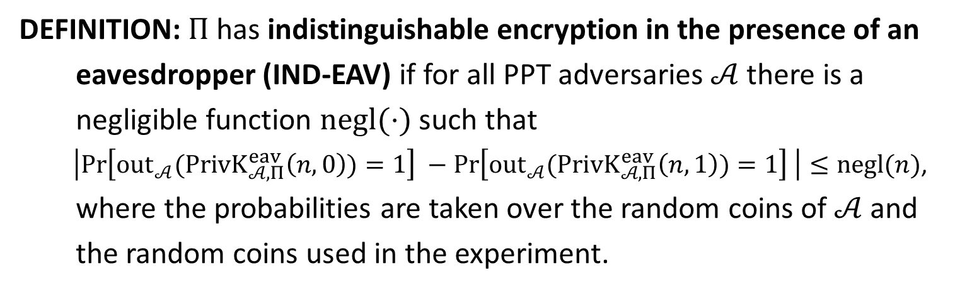
IND-EAV
DEFINITION: $Π$has indistinguishable encryption in the presence of an
eavesdropper (IND-EAV) if for all PPT adversaries $𝒜$ there is a
negligible function $negl(⋅)$ such that
$\left|\operatorname{Pr}\left[{out}_{𝒜}(PrivK_{𝒜, Π}^{eav}\left(n,0\right))=1\right] −\operatorname{Pr}\left[{out}_{𝒜}(PrivK_{𝒜, Π}^{eav}\left(n,1\right))=1\right] \right|≤negl(n)$,
where the probabilities are taken over the random coins of $𝒜$ and
the random coins used in the experiment.

Slide 13
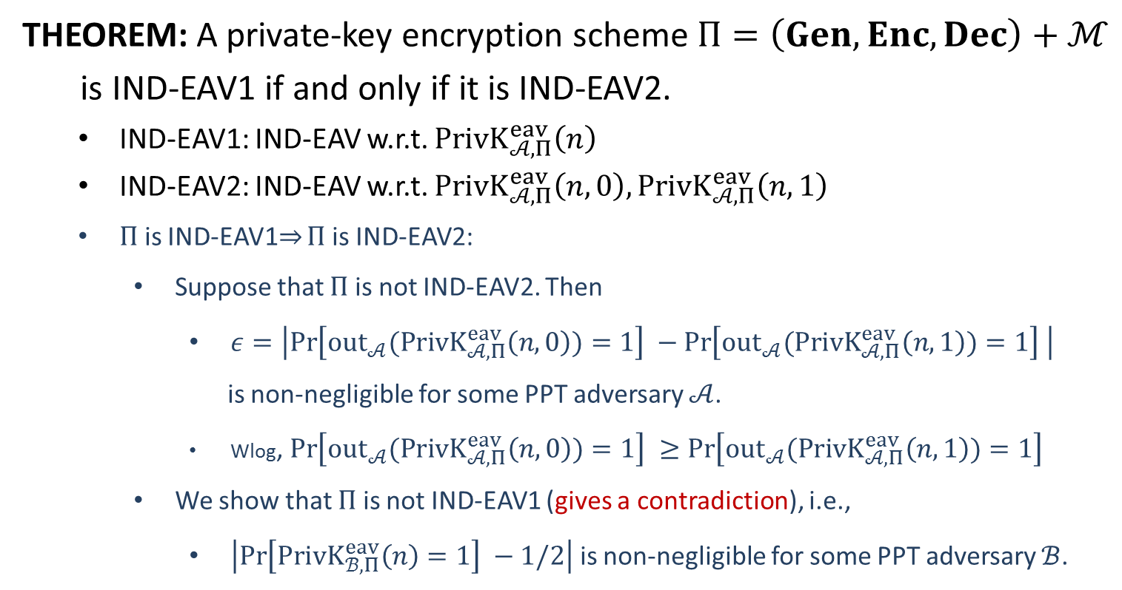
Equivalence
THEOREM: A private-key encryption scheme $Π=\left(Gen, Enc, Dec\right)+ℳ$
is IND-EAV1 if and only if it is IND-EAV2.
IND-EAV1: IND-EAV w.r.t. $PrivK_{𝒜, Π}^{eav}\left(n\right)$
IND-EAV2: IND-EAV w.r.t. $PrivK_{𝒜, Π}^{eav}\left(n,0\right),PrivK_{𝒜, Π}^{eav}\left(n,1\right)$
$Π$ is IND-EAV1$⇒$ $Π$ is IND-EAV2:
Suppose that $Π$ is not IND-EAV2. Then
$ε=\left|\operatorname{Pr}\left[{out}_{𝒜}(PrivK_{𝒜, Π}^{eav}\left(n,0\right))=1\right] −\operatorname{Pr}\left[{out}_{𝒜}(PrivK_{𝒜, Π}^{eav}\left(n,1\right))=1\right] \right|$
is non-negligible for some PPT adversary $𝒜$.
Wlog, $\operatorname{Pr}\left[{out}_{𝒜}(PrivK_{𝒜, Π}^{eav}\left(n,0\right))=1\right] ≥\operatorname{Pr}\left[{out}_{𝒜}(PrivK_{𝒜, Π}^{eav}\left(n,1\right))=1\right]$
We show that $Π$ is not IND-EAV1 (gives a contradiction), i.e.,
$\left|\operatorname{Pr}\left[PrivK_{ℬ, Π}^{eav}\left(n\right)=1\right] −1/2\right|$ is non-negligible for some PPT adversary $ℬ$.

Slide 14












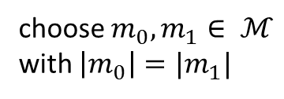


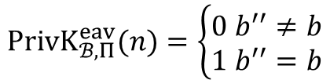

choose $m_{0}, m_{1}∈ ℳ$
with $\left|m_{0}\right|=|m_{1}|$
$$m_{0},m_{1}$$
$$m_{0},m_{1}$$
$$k←Gen\left(1^{n}\right)$$
$$b←\{0,1\}$$
$$c←Enc(k,m_{b})$$
$$c$$
$$c$$
$$b′$$
$$b^{′′}=\left\{\begin{aligned}0 b^{′}=1 \\ 1 b^{′}=0\end{aligned}\right.$$
$$b′′$$
$$PrivK_{ℬ, Π}^{eav}(n)=\left\{\begin{aligned}0 b^{′′}≠b \\ 1 b^{′′}=b\end{aligned}\right.$$
$$Challenger$$
$$𝓑$$
$$𝓐$$
$$PrivK_{𝓑 , Π}^{eav}\left(n\right)$$
$$PrivK_{𝒜, Π}^{eav}\left(n,b\right)$$

Slide 15
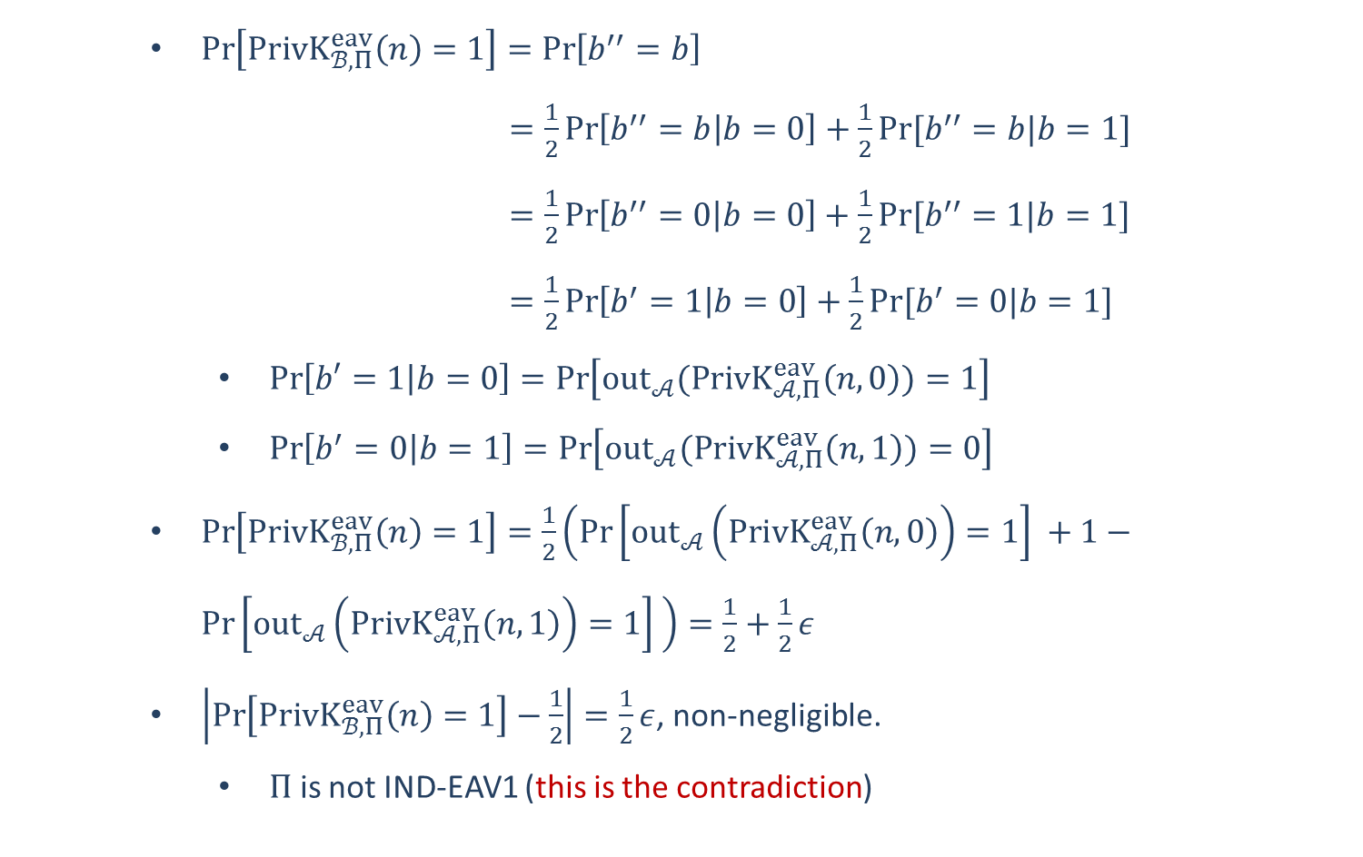
$\operatorname{Pr}\left[PrivK_{ℬ, Π}^{eav}\left(n\right)=1\right]=\operatorname{Pr}\left[b^{′′}=b\right]$
$=\frac{1}{2}\operatorname{Pr}\left[b^{′′}=b | b=0\right]+\frac{1}{2}Pr⁡[b^{′′}=b|b=1]$
$=\frac{1}{2}\operatorname{Pr}\left[b^{′′}=0 | b=0\right]+\frac{1}{2}Pr⁡[b^{′′}=1|b=1]$
$=\frac{1}{2}\operatorname{Pr}\left[b^{′}=1 | b=0\right]+\frac{1}{2}Pr⁡[b^{′}=0|b=1]$
$\operatorname{Pr}\left[b′=1 | b=0\right]=\operatorname{Pr}\left[{out}_{𝒜}(PrivK_{𝒜, Π}^{eav}\left(n,0\right))=1\right]$
$\operatorname{Pr}\left[b^{′}=0 | b=1\right]=\operatorname{Pr}\left[{out}_{𝒜}(PrivK_{𝒜, Π}^{eav}\left(n,1\right))=0\right]$
$\operatorname{Pr}\left[PrivK_{ℬ, Π}^{eav}\left(n\right)=1\right]=\frac{1}{2}\left(\operatorname{Pr}\left[{out}_{𝒜}\left(PrivK_{𝒜, Π}^{eav}\left(n,0\right)\right)=1\right] +1−\operatorname{Pr}\left[{out}_{𝒜}\left(PrivK_{𝒜, Π}^{eav}\left(n,1\right)\right)=1\right] \right)=\frac{1}{2}+\frac{1}{2}ε$
$\left|\operatorname{Pr}\left[PrivK_{ℬ, Π}^{eav}\left(n\right)=1\right]−\frac{1}{2}\right|=\frac{1}{2}ε$, non-negligible.
$Π$ is not IND-EAV1 (this is the contradiction)

Slide 16
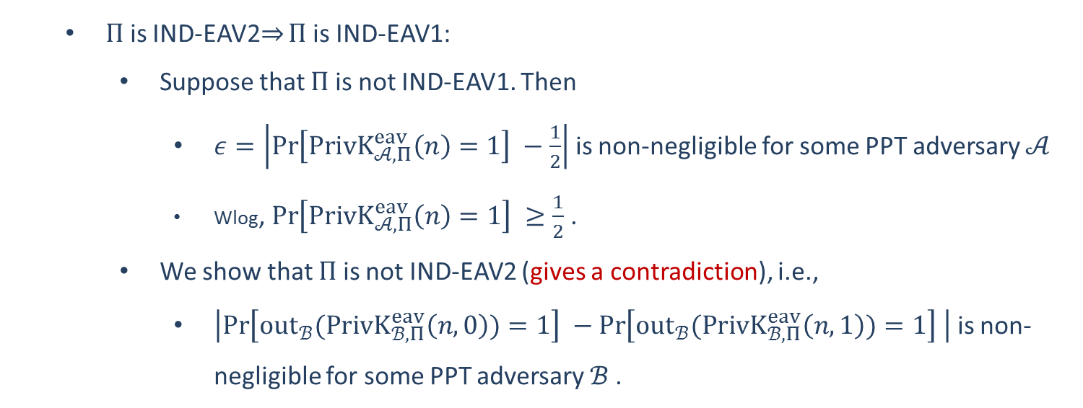
$Π$ is IND-EAV2$⇒$ $Π$ is IND-EAV1:
Suppose that $Π$ is not IND-EAV1. Then
$ε=\left|\operatorname{Pr}\left[PrivK_{𝒜, Π}^{eav}\left(n\right)=1\right] −\frac{1}{2}\right|$ is non-negligible for some PPT adversary $𝒜$
Wlog, $\operatorname{Pr}\left[PrivK_{𝒜, Π}^{eav}\left(n\right)=1\right] ≥\frac{1}{2}$ .
We show that $Π$ is not IND-EAV2 (gives a contradiction), i.e.,
$\left|\operatorname{Pr}\left[{out}_{ℬ}(PrivK_{ℬ, Π}^{eav}\left(n,0\right))=1\right] −\operatorname{Pr}\left[{out}_{ℬ}(PrivK_{ℬ, Π}^{eav}\left(n,1\right))=1\right] \right|$ is non-negligible for some PPT adversary $ℬ$.

Slide 17
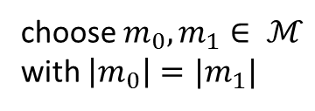













choose $m_{0}, m_{1}∈ ℳ$
with $\left|m_{0}\right|=|m_{1}|$
$$m_{0},m_{1}$$
$$m_{0},m_{1}$$
$$k←Gen\left(1^{n}\right)$$
$$c←Enc(k,m_{b})$$
$$c$$
$$c$$
$$b′$$
$$b′$$
$$Challenger$$
$$𝓑$$
$$𝓐$$
$$PrivK_{𝓑 , Π}^{eav}\left(n,b\right)$$
$$PrivK_{𝒜, Π}^{eav}\left(n\right)$$

Slide 18
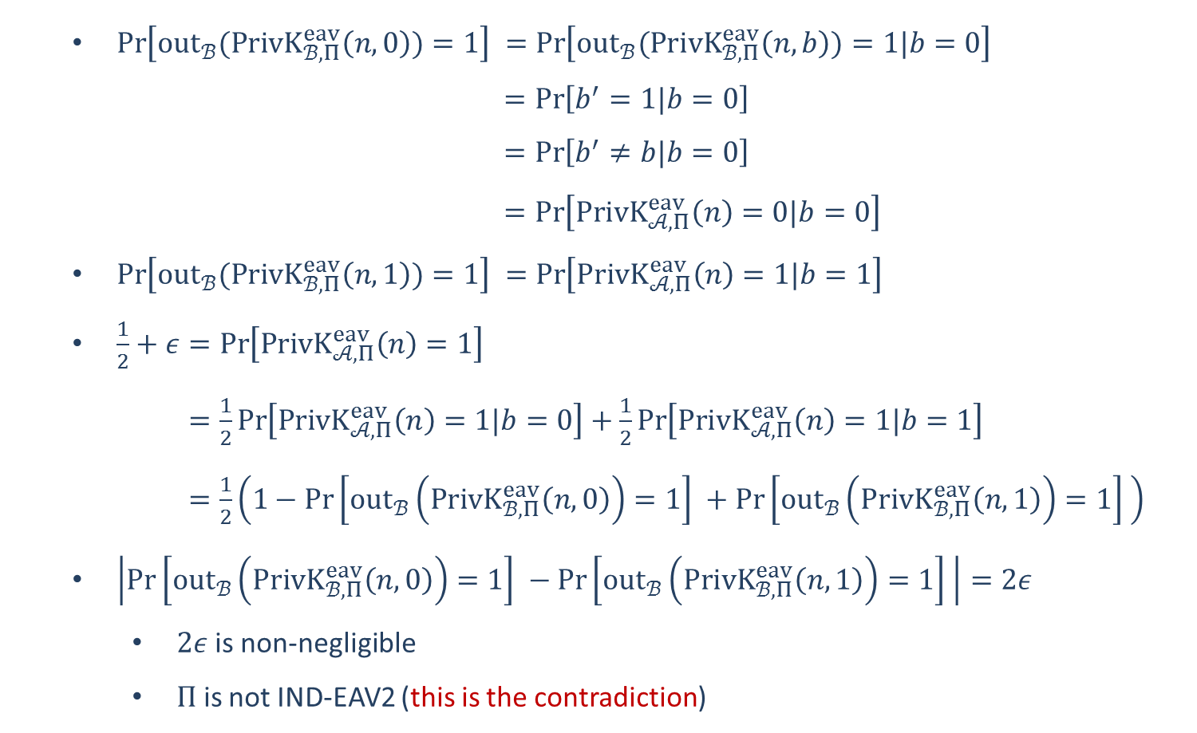
$\operatorname{Pr}\left[{out}_{ℬ}(PrivK_{ℬ, Π}^{eav}\left(n,0\right))=1\right] =\operatorname{Pr}\left[{out}_{ℬ}(PrivK_{ℬ, Π}^{eav}\left(n,b\right))=1|b=0\right]$
$=\operatorname{Pr}\left[b^{′}=1|b=0\right]$
$=\operatorname{Pr}\left[b^{′}≠b|b=0\right]$
$=\operatorname{Pr}\left[PrivK_{𝒜, Π}^{eav}\left(n\right)=0|b=0\right]$
$\operatorname{Pr}\left[{out}_{ℬ}(PrivK_{ℬ, Π}^{eav}\left(n,1\right))=1\right] =\operatorname{Pr}\left[PrivK_{𝒜, Π}^{eav}\left(n\right)=1|b=1\right]$
$\frac{1}{2}+ε=\operatorname{Pr}\left[PrivK_{𝒜, Π}^{eav}\left(n\right)=1\right]$
$=\frac{1}{2}\operatorname{Pr}\left[PrivK_{𝒜, Π}^{eav}\left(n\right)=1|b=0\right]+\frac{1}{2}\operatorname{Pr}\left[PrivK_{𝒜, Π}^{eav}\left(n\right)=1|b=1\right]$
$=\frac{1}{2}\left(1−\operatorname{Pr}\left[{out}_{ℬ}\left(PrivK_{ℬ, Π}^{eav}\left(n,0\right)\right)=1\right] +\operatorname{Pr}\left[{out}_{ℬ}\left(PrivK_{ℬ, Π}^{eav}\left(n,1\right)\right)=1\right] \right)$
$\left|\operatorname{Pr}\left[{out}_{ℬ}\left(PrivK_{ℬ, Π}^{eav}\left(n,0\right)\right)=1\right] −\operatorname{Pr}\left[{out}_{ℬ}\left(PrivK_{ℬ, Π}^{eav}\left(n,1\right)\right)=1\right] \right|=2ε$
$2ε$is non-negligible
$Π$ is not IND-EAV2 (this is the contradiction)

Slide 19

















OTP is IND-EAV
$$m_{0},m_{1}$$
choose $m_{0}, m_{1}∈{\left\{0,1\right\}}^{n}$
$$k←{\left\{0,1\right\}}^{n}$$
$$c←k⊕m_{0}$$
$$Adversary 𝒜$$
$$Challenger$$
$$c$$
$$b^{′}$$
$$m_{0},m_{1}$$
choose $m_{0}, m_{1}∈{\left\{0,1\right\}}^{n}$
$$k←{\left\{0,1\right\}}^{n}$$
$$Challenger$$
$$c←k⊕m_{1}$$
$$Adversary 𝒜$$
$$c$$
$$b^{′}$$
$$k⊕m_{0}≡k⊕m_{1}$$
$$\operatorname{Pr}\left[{out}_{𝒜}(PrivK_{𝒜, OTP}^{eav}\left(n,0\right))=1\right] =\operatorname{Pr}\left[{out}_{𝒜}(PrivK_{𝒜, OTP}^{eav}\left(n,1\right))=1\right]$$

Slide 20
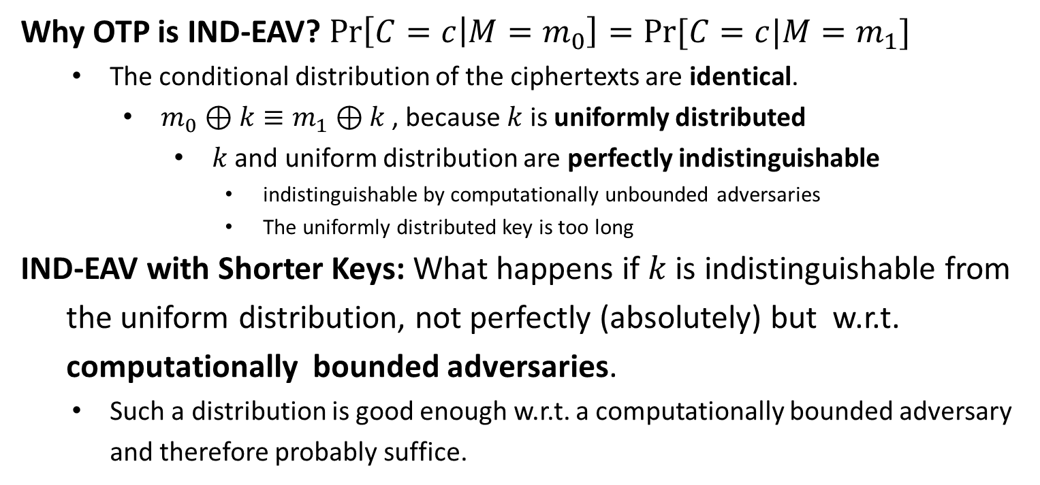
OTP is IND-EAV
Why OTP is IND-EAV? $\operatorname{Pr}\left[C=c | M=m_{0}\right]=Pr⁡[C=c|M=m_{1}]$
The conditional distribution of the ciphertexts are identical.
$m_{0}⊕k≡m_{1}⊕k$ , because $k$ is uniformly distributed
$k$ and uniform distribution are perfectly indistinguishable
indistinguishable by computationally unbounded adversaries
The uniformly distributed key is too long
IND-EAV with Shorter Keys: What happens if $k$ is indistinguishable from
the uniform distribution, not perfectly (absolutely) but w.r.t.
computationally bounded adversaries.
Such a distribution is good enough w.r.t. a computationally bounded adversary and therefore probably suffice.

